Slide 1

Leadership

Slide 2
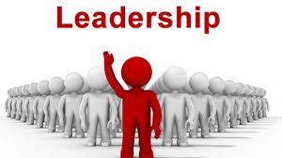
What is leadership
“One who has follower” Peter Drucker
“Leadership is the name of influence” Jhon C. Maxwell
“If your actions inspire others to dream more, learn more, do more, and become more, you are a leader” Jhon Quincy Adams
Continued…

Slide 3
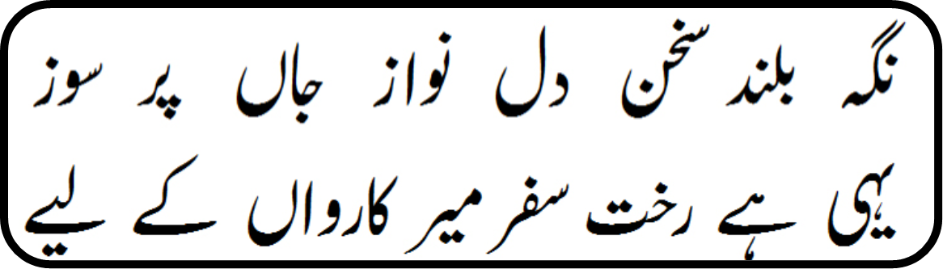
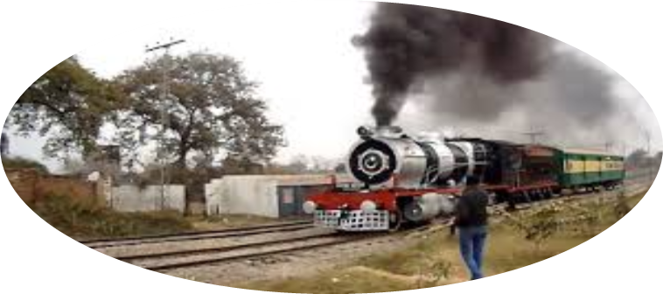
By Allama Muhammad Iqbal
By Baoo Gi

Slide 4


Characteristics of Leadership
State of mind
Character
Vision
Bonding force for people (Team Management)
Make people work (Motivation)
DNA of Leader
Driving force
Desire to lead
Desire to take responsibility
Integrity
Self confidence
Intelligence
Job relevant knowledge

Slide 5
Working of a Leader:
Create Vision
Build Team
Motivate Followers
Develop People
Allocate Tasks

Slide 6
The End

